Slide 1

Underwater Image Enhancement Based on Adaptive Color Correction and Improved Retinex Algorithm
Presented by
S. Raiyan (22KH5A0417)
K. Kishore (22KH5A0410)
S. Reshma Begum (21KH1A0475)
S. Fathima Arfa (21KH1A0483)
Under the Guidance of
Mrs.Y.Sravani, M.Tech.,
Assistant Professor, Dept. of ECE
Sri Venkateswara College Of Engineering
(Approved by AICTE, New Delhi and Affiliated to JNTUA, Ananthapuramu)
Balaji Nagar, Kadapa -516003, A.P.

Slide 2
CONTENTS
ABSTRACT
INTRODUCTION
EXISTING METHOD
PROPOSED METHOD
SOFTWARE REQUIREMENTS
RESULTS
CONCLUSION
FUTURE SCOPE
REFERENCE

Slide 3
ABSTRACT
Underwater applications require clear underwater images, however, blurring and contrast degradation in underwater images are caused by absorption, dispersion, and water mass. To address the limitations of existing color correction and deblurring algorithms, this study proposes a fusion-based image enhancement algorithm. Two images obtained by adaptive channel defogging technique and restricted histogram mapping interval correction technique are used as two inputs to the fusion framework to obtain a new underwater image. We tested our technique with a public dataset. The experimental evidence shows that the technique proposed in this paper can improve the quality and detail of blurred underwater images. This paper also demonstrates that the method has superior deblurring and color correction capabilities than other existing algorithms.

Slide 4
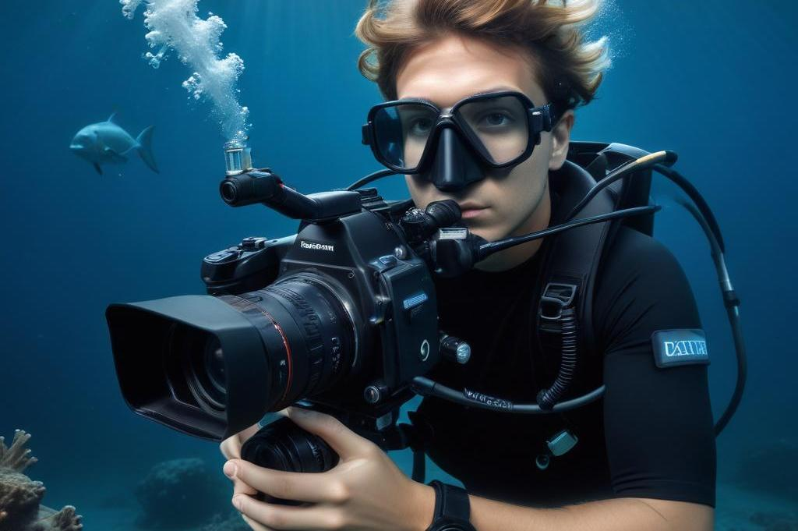
INTRODUCTION
Underwater images often suffer from color distortion and low contrast due to the scattering and absorption of light in aquatic environments. To address these challenges, researchers have developed enhancement algorithms that combine adaptive color correction with improved Retinex methods.

Slide 5
With the increasing shortage of resources on land, the ocean, which is rich in oil and mineral resources, has been eagerly explored.
Obtaining high-quality and clear underwater images is an important guarantee for the development of underwater vehicle control, underwater infrastructure inspection, and marine biological research.
Therefore, enhancing the visual effects of underwater images is an important part of ocean exploration.
However, due to the attenuation and scattering of light in water, problems such as color cast, image blurring, and low contrast appear in underwater images.

Slide 6
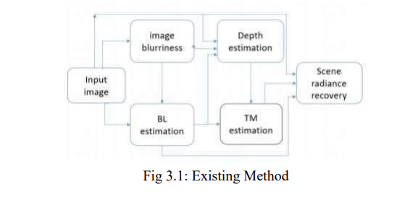
EXISTING METHOD
Underwater image restoration using depth map estimation.
Image blurriness is used as a before acquiring a depth map.
As depth increases, image blurriness also gets increased. Here backlight is retrieved from the largest blurriness region and lowest variance region.
A backlight is estimated from the top brightest pixel.

Slide 7
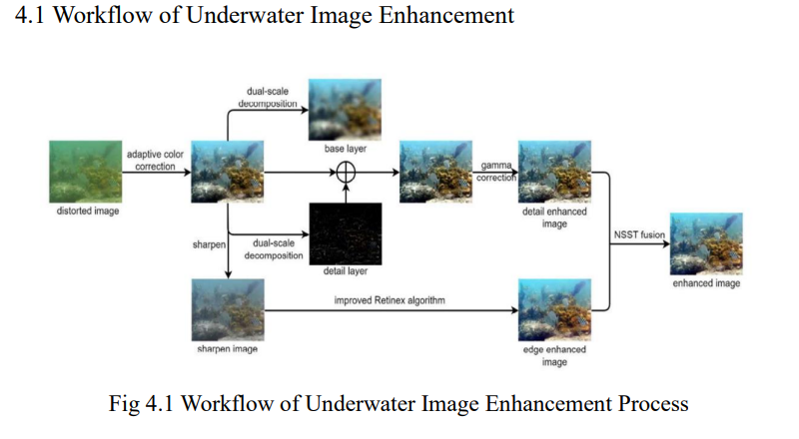
Proposed Method

Slide 8
This project addresses the limitation of weak generalization in non-physical modelbased methods for underwater image enhancement.
To overcome this, we introduce an adaptive underwater image enhancement method designed to perform effectively with complex underwater images, drawing inspiration from the work.
Our method employs a combination of color correction, contrast enhancement, tone adjustment, and image fusion techniques to achieve improved underwater image enhancement.

Slide 9
Concept of adaptive color correction
Adaptive algorithms dynamically adjust color parameters based on real- time data, enhancing visual quality and ensuring consistent results across varying conditions
Improved visual quality:
Enhances details in shadow and highlight areas and corrects color distortions.
Consistency:
Ensures that images or videos maintain consistent color accuracy under varying conditions.
Real-time processing:
Useful in live video feeds or applications where immediate correction is needed (e.g., video conferencing, streaming).

Slide 10
IMPROVING RETINEX ALGORITHM
Introduction To Retinex :
Original retinex model
The Retinex model was developed to explain human color constancy and to enhance image quality by improving contrast and brightness.
Challenges and limitations
Despite its benefits, the original Retinex model struggles with computational complexity, processing time, and may produce halo artifacts in high- contrast areas.

Slide 11
Non-Subsampled Shearlet Transform (NSST) Fusion
Refers to the process of combining information from Multiple sources or images to improve the quality of underwater photographs.
Underwater images often suffer from various challenges, such as color distortion, low contrast, and blurring due tofactors like poor lighting, water turbidity, and absorption of light
by water

Slide 12
SOFTWARE REQUIREMENTS
Introduction to MATLAB The name MATLAB stands for Matrix Laboratory.
The software is built up around vectors and matrices.
This makes the software particularly useful for linear algebra but MATLAB is also a great tool for solving algebraic and differential equations and for numerical integration.
MATLAB has powerful graphic tools and can produce nice pictures in both 2D and 3D.
It is also a programming language, and is one of the easiest programming languages for writing mathematical programs. These factors make MATLAB an excellent tool for teaching and research.

Slide 13
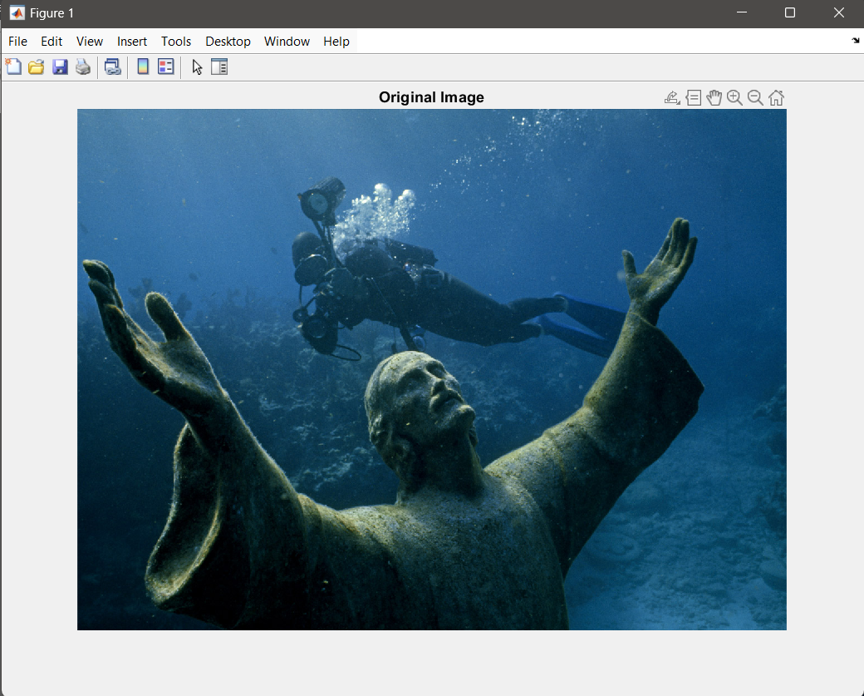
INPUT IMAGE

Slide 14
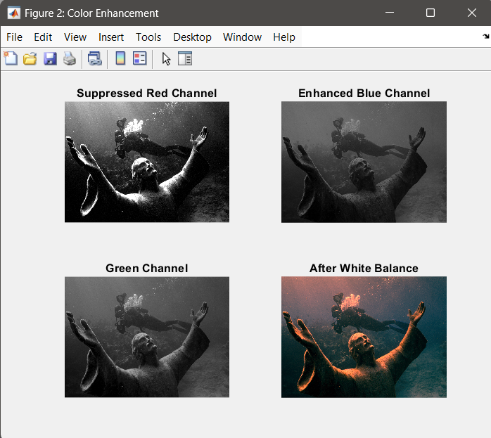
SEPRATION RGB COMPONENTS
In an RGB image, each pixel's color is represented by three values: red, green, and blue, each ranging from 0 to 255, forming a 24-bit color representation
24-bit Color:
Since each pixel is represented by three 8-bit values (one for each color channel), RGB images are often referred to as 24-bit color images, capable of displaying a wide range of colors

Slide 15
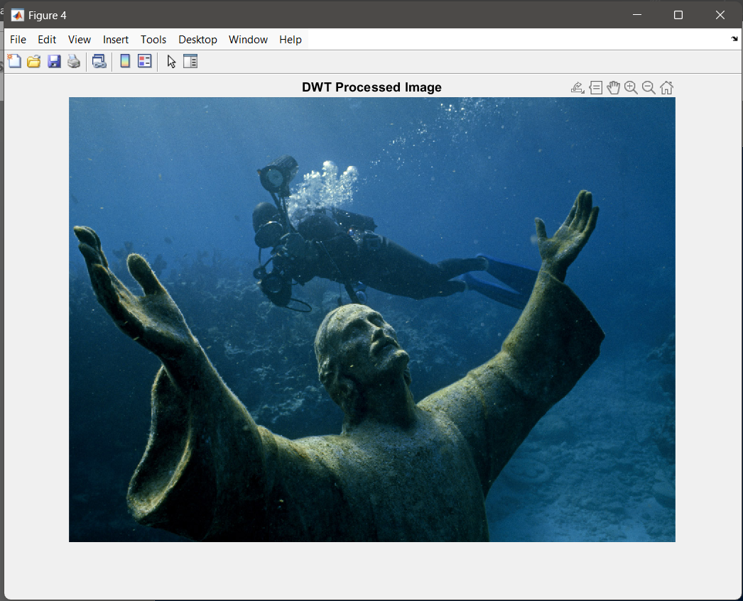
APPLYING DWT TRANSFORMATION
The 2D Discrete Wavelet Transform (2D-DWT) is a technique in image processing that decomposes an image into different frequency components using a multiresolution representation, enabling analysis and manipulation at various scales

Slide 16
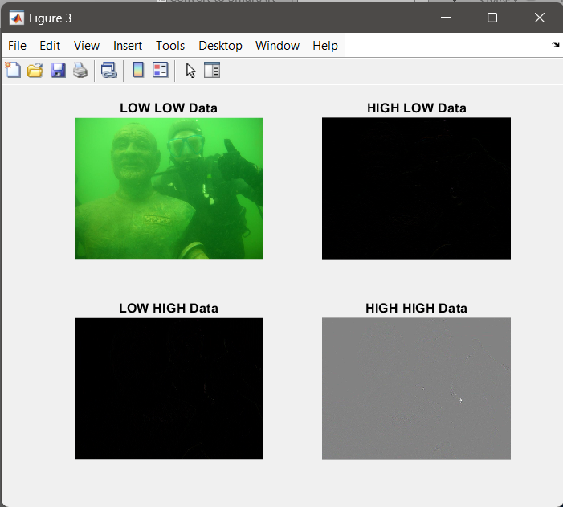
EXTRACTING HIGH INTENSITY DATA
Decomposition into Subbands:
The 2D-DWT decomposes an image into four subbands: low-low (LL), low-high (LH), high-low (HL), and high-high (HH), representing different frequency content.
LLr → Low-Low (approximation) LHr → Low-High (horizontal edges) HLr → High-Low (vertical edges) HHr → High-High (diagonal edges)

Slide 17
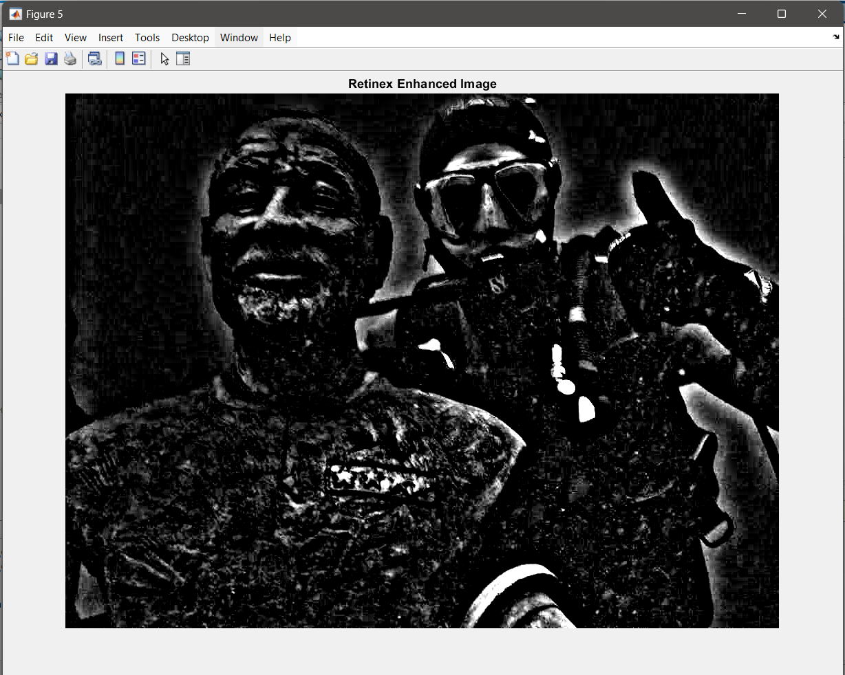
RETINEX ALGORITHM
Retinex algorithm aims to enhance image quality, particularly in low-light conditions, by estimating and separating the illumination and reflectance components of an image, resulting in an image with improved brightness, contrast, and color constancy

Slide 18
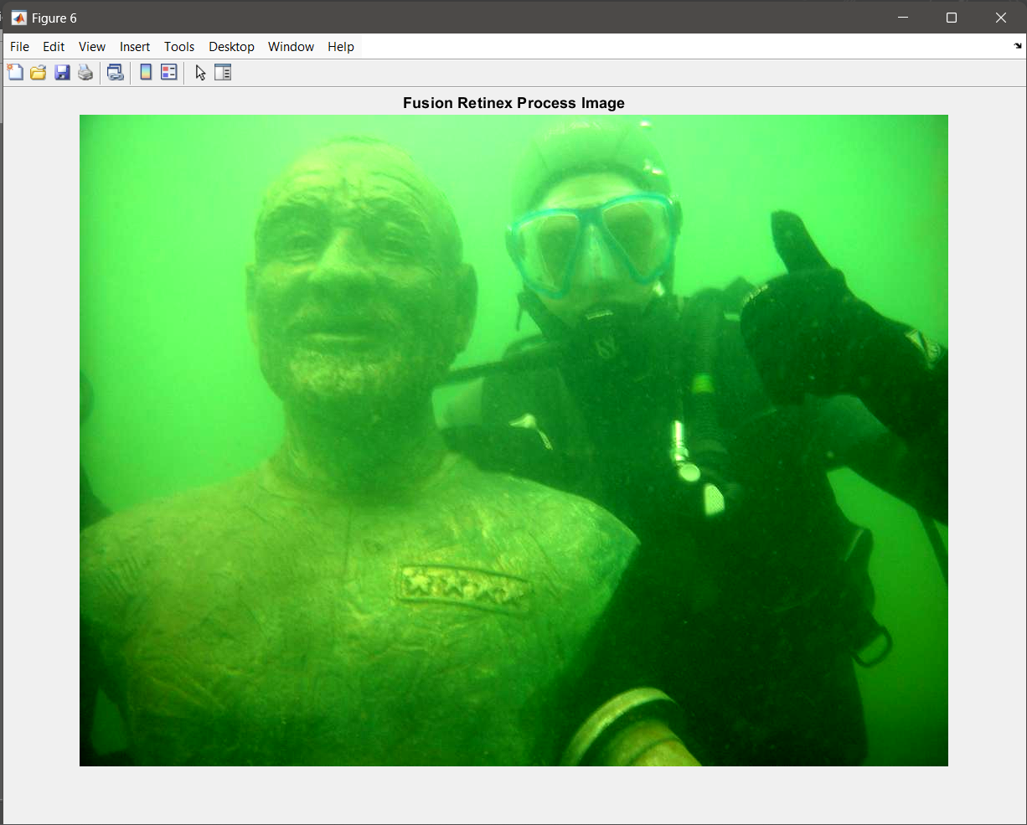
NSST FUSION PROCESS / BALANCING WEIGHT MATRIX DATA
During the NSST fusion process, source images are decomposed into low-frequency and high-frequency sub-bands. The low-frequency components typically contain the approximate information or base layers of the images, while the high-frequency components capture detailed features such as edges and textures.

Slide 19

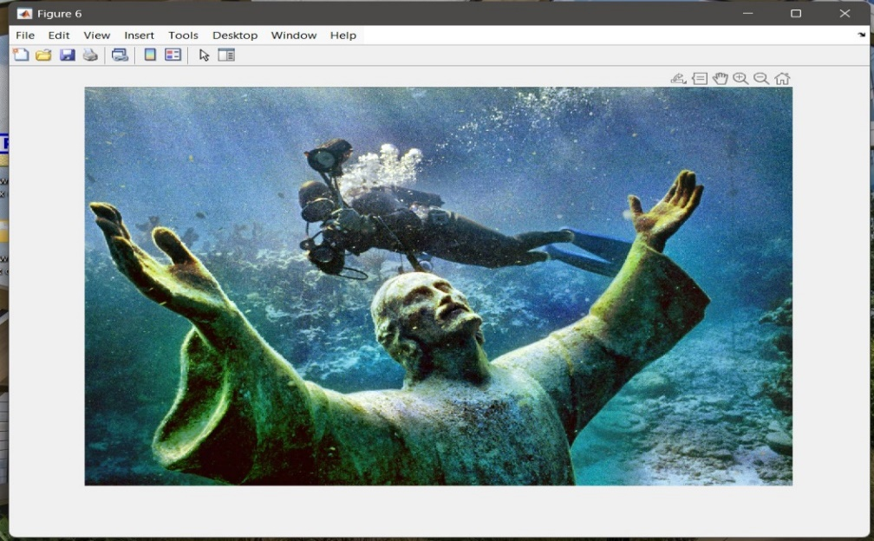
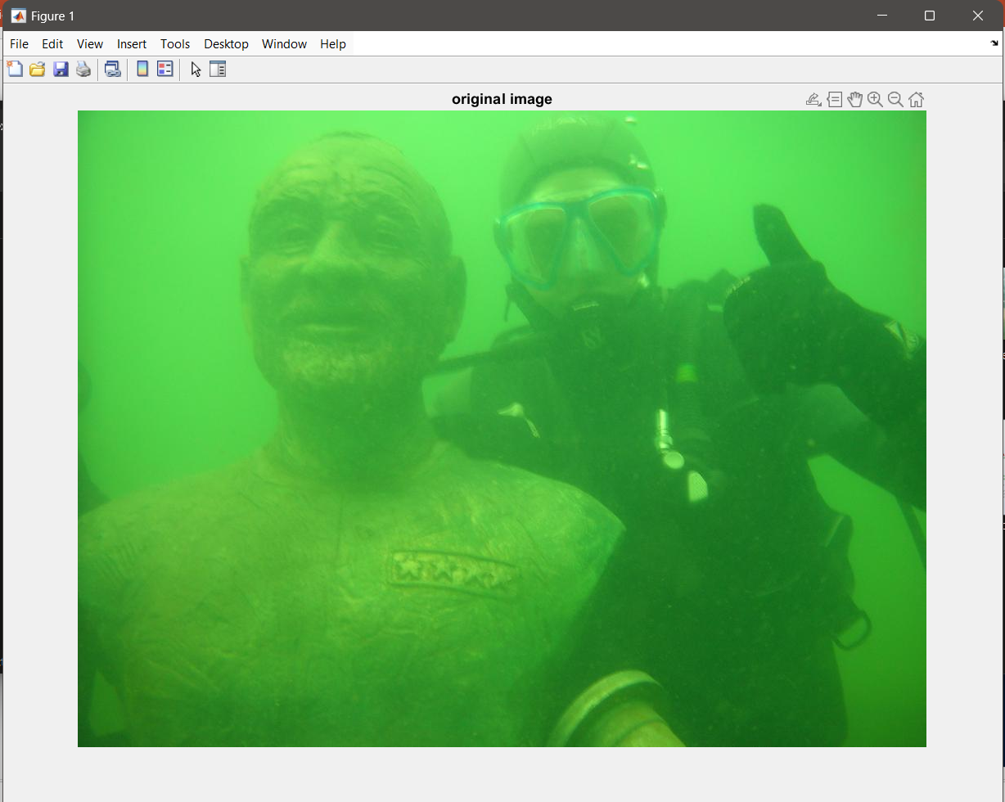
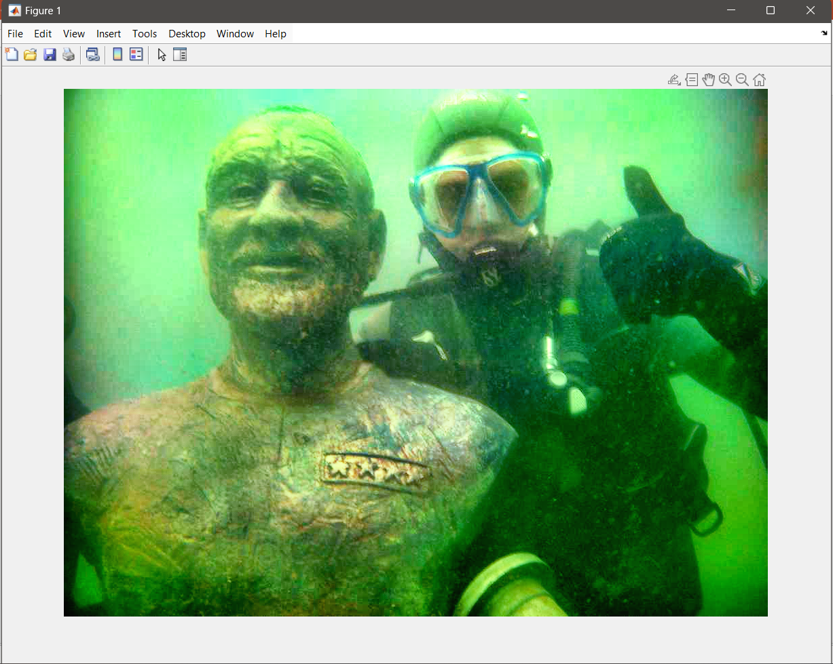
Results :
INPUT IMAGE
RESULT

Slide 20
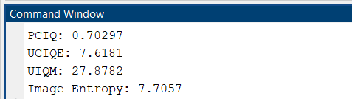
Underwater Image Quality Metrics :
PCIQ (Perceptual Color Image Quality) Focus: Color preservation and natural appearance. Ideal Range: 0.5 to 1.0 (closer to 1 is better). UCIQE (Underwater Color Image Quality Evaluation) Focus: Chroma, contrast, and sharpness. Ideal Range: 5 to 10 (values >5 indicate better clarity). UIQM (Underwater Image Quality Measure) Focus: Combines colorfulness, sharpness, and contrast. Ideal Range: 10 to 40 (values >25 indicate high quality). IE (Image Entropy) Focus: Detail and information content. Ideal: Higher values are better (preferably >6).

Slide 21
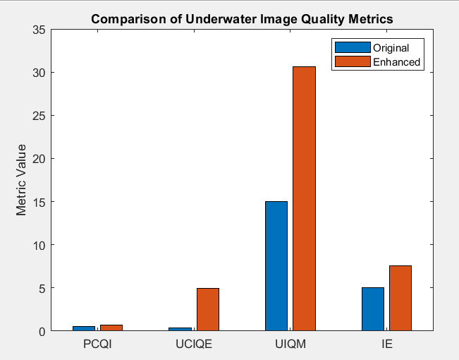

Slide 22
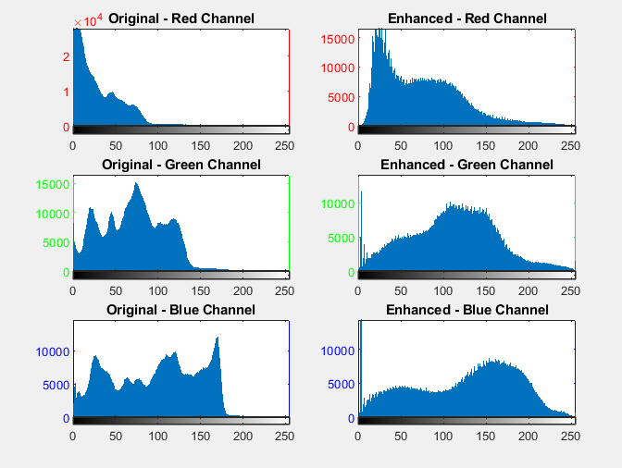
RBG Histogram

Slide 23
CONCLUSION
The complex underwater environment causes the problems about color distortion, low contrast and image blur. Aiming at these phenomena, we propose an underwater image enhancement algorithm based on adaptive color correction and improved Retinex algorithm. The designed adaptive color correction algorithm can effectively remove various color distortion. The improved Retinex algorithm can enhance the details and edges of the color corrected image. The detail enhanced image and the edge enhanced image are fused through NSST to produce the final enhanced image.

Slide 24
FUTURE SCOPE
AI & Deep Learning Integration:
CNNs and GANs for automated image enhancement.
AI-driven self-learning models for adaptive enhancement.
Automated feature extraction for marine research.
Real-Time Processing for AUVs & Robotics:
Faster adaptive enhancement algorithms for underwater drones.
GPU & FPGA acceleration for real-time processing.
Navigation improvement for deep-sea exploration.
Multispectral & Hyperspectral Imaging:
Enhancing images beyond RGB using multiple spectral bands.
Adaptive filtering for different wavelengths.

Slide 25
REFERENCES
[1] Li Wujin, Peng Yishu, Ou Xianfeng, Wu Jianhui, Guo Longyuan, Zhang Yiming, Huang Feng, Xu Zhi. Low illumination image enhancement method based on improved Retinex algorithm[J].Journal of Chengdu Institute of Technology,2020,23(02):20-25.
[2] Tang Zhongqiang, Zhou Bo, Dai Xianzhong, Gu Haitao. Vision enhancement of underwater vehicle based on improved DCP algorithm [J]. Robot,2018,40(02):222-230.
[3] Li she Lei, Li Haitao, Cui Congying. Underwater image enhancement algorithm based on dark primary color prior model [J]. Computer technology and development,2018,28(10):70-73.
[4] Huo Guangyao, Dian Songyi, Wu weirang, Yu Tong, Li Miao. Underwater image processing based on dark channel prior and adaptive color correction [J]. Electrooptic and control, 2019, 26(11):70-74.
[5] He Xiao, turhongjiang, abduklim, he Huan. Color underwater image enhancement algorithm based on gamma transform and Retinex [J]. Science and technology perspective,2020,(3):41-42.
[6] Yang Fuhao, Shi Qichao, LAN Fangming, Peng Zongju. Underwater image enhancement based on color attenuation compensation and Retinex [J]. Journal of Ningbo University (Science and Engineering Edition),2020,33(1):58-64.

